Slide 1
GENDER GAP ANALYSIS
Submitted in the partial fulfillment for the award of the degree of
BACHELOR OF ENGINEERING
IN
Big Data Analytics
Submitted by:
Piyush Shukla 20BCS3871
Under the Supervision of:
Dr Monika Singh
Department of AIT-CSE
DISCOVER . LEARN . EMPOWER

Slide 2
Outline
Introduction
Scope of the Project
Planning to implement

Slide 3
Introduction
In the rapidly evolving landscape of digital technologies, the digital gender gap remains a critical and complex challenge. While India has witnessed significant advancements in technology adoption, a pronounced disparity between men and women in terms of digital access, usage, and participation persists. This disparity, commonly referred to as the "digital gender gap," raises concerns about gender equality, economic empowerment, and social inclusion. The problem's complexity is further compounded by socio-cultural norms, economic disparities, and geographical factors that shape the digital experiences of women across diverse regions in India.

Slide 4
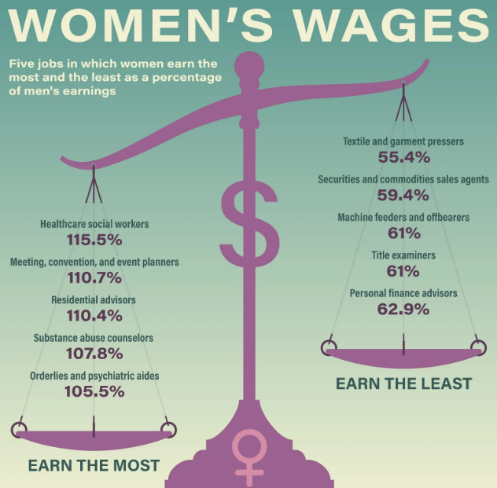
Scope of the Project
This research paper aims to comprehensively examine the disparities between men and women in terms of access to and usage of digital technologies.

Slide 5
Scope of the Project
The primary scope of this project can be summarized as follows:
Internet access and usage disparities between genders across urban and rural areas.
Levels of digital literacy and skills among women compared to men.
Participation of women in the technology workforce, including employment and leadership roles.
Differences in access to and use of online services, e-commerce, and digital platforms.
Examination of socio-cultural norms, perceptions, and attitudes affecting women's engagement with digital technologies.
Exploration of government policies and initiatives focused on gender-inclusive digital development.
Impact of the urban-rural divide on women's digital inclusion.

Slide 6
Planning to implement
The analysis of the digital gender gap involves a systematic approach utilizing Python programming and its associated libraries to process, analyze, and derive insights from the collected data. The following is an outline of the steps involved in this analytical process.
1. Data Preparation and Loading .
2. Descriptive Statistics and Comparative Analysis:
3. Data Visualization:
4. Correlation Analysis and Qualitative Insights:
5. Reporting and Collaboration

Slide 7
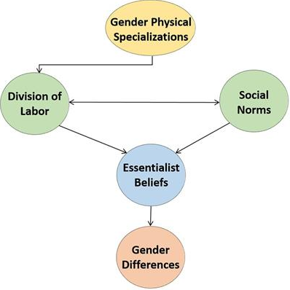
Linking gender differences with gender equality

Slide 8
Thank you

